Slide 1
Online Ordering App
Application Template Specification

Slide 2
Overview
Our aim is to create reusable application templates for developers. Right now we are focusing on online ordering application for busy small business owners. This project is to build general template for the regular structure of online ordering application.
We are modeling this screens on the app builder by AppInstitute web-site
AppInstitute link: https://appinstitute.com

Slide 3
Required Experience
Embarcadero Delphi 10.3 Rio.
The FireMonkey cross-platform application framework for Android and iOS development.
POS-systems best practices with proper user interface and user experience.
Easy developer customization and deployment

Slide 4
Specifics
Specifically we are working on something similar to general existing online ordering applications.
The goal is to have a reusable template that a user can download and add their own content to and create a professional looking application.
The template will be delivered in a sample application that shows the power and flexibility of the template, and that is documented enough so that a user will understand how to customize it for their use. On the following slides you will find screenshots and annotations

Slide 5
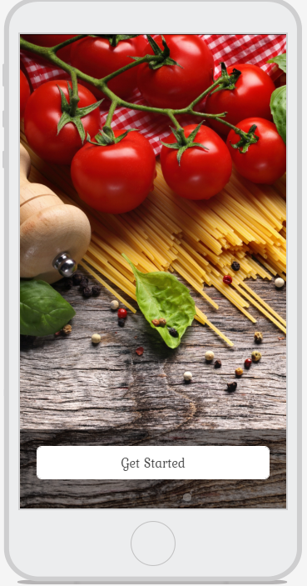
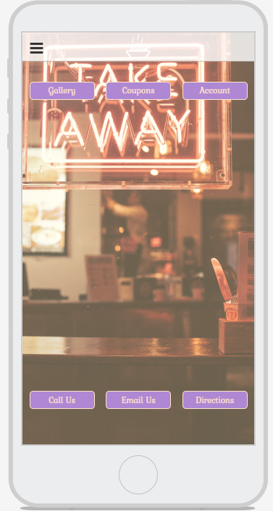
Menu button
The content slides added here will be displayed on the first app launch and if the app is locked.
This dashboard is a flexible screen to provide additional navigation options:
Gallery
Coupons
Account
Call Us
Email Us
Directions
Opens Dashboard

Slide 6
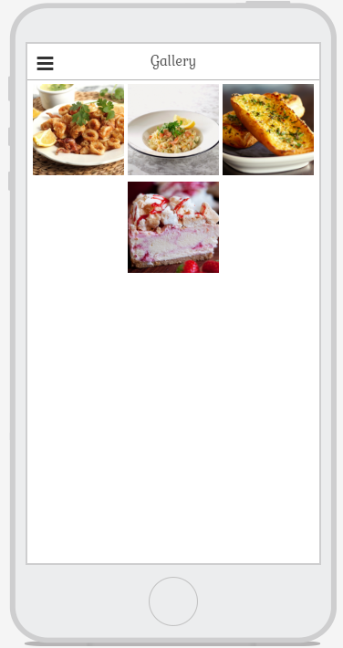
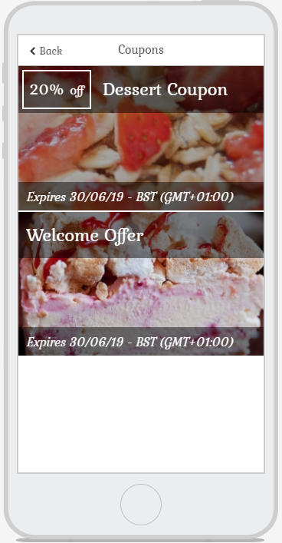
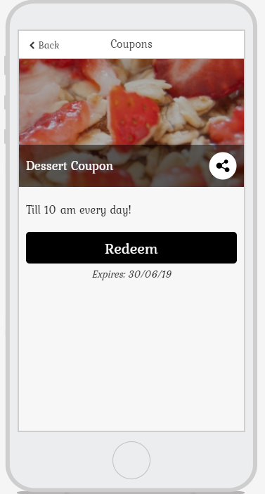
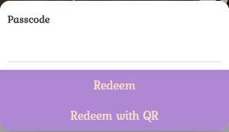
Gallery tabs show photos. Photos could be organized with drag and drop
Coupon screen with all
details, share and redeem buttons
List of coupons with information

Slide 7
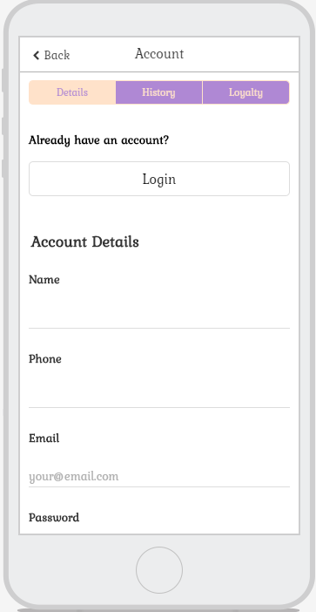
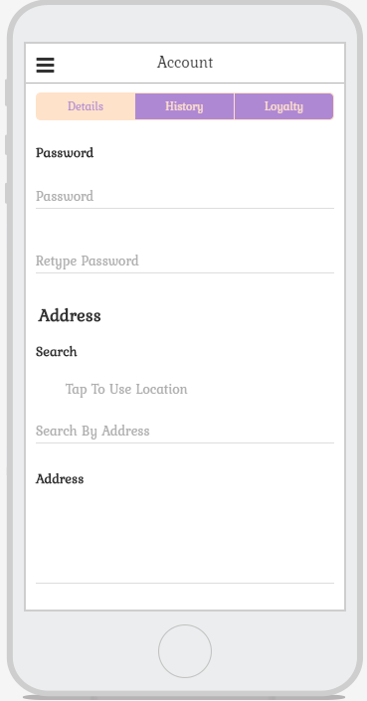
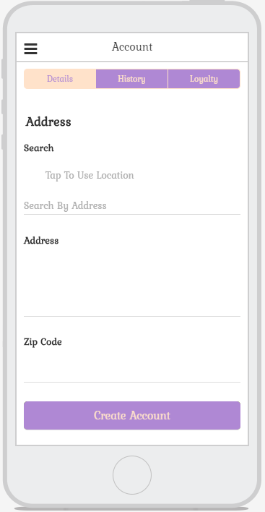
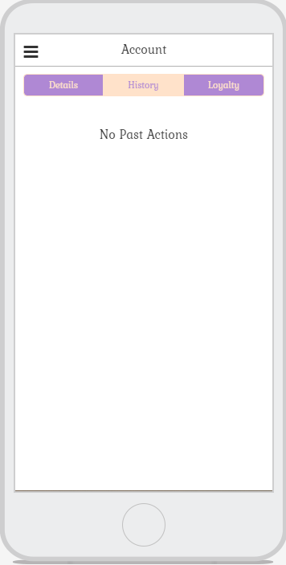

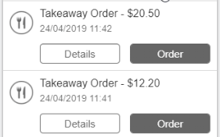
Changes to Sign In if click
Order details
Order details and ability to checkout

Slide 8
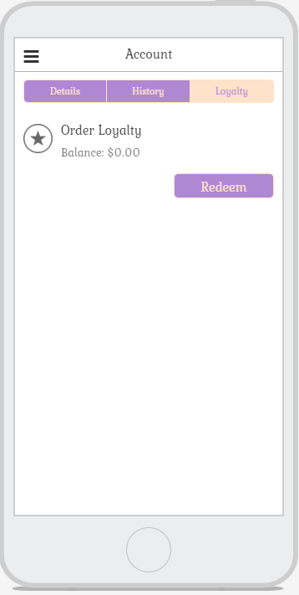
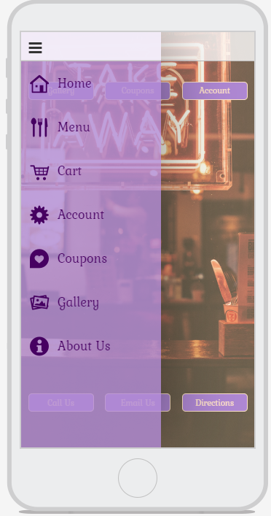
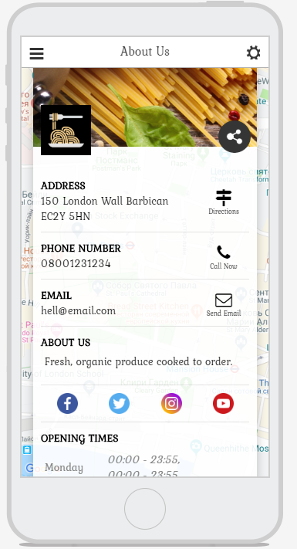
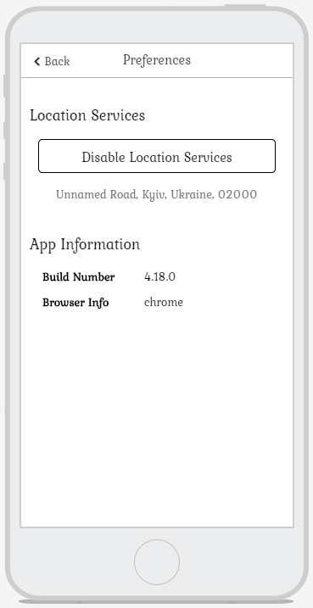
Logos
Share
Customer loyalty balance for orders
Location on/off
Transparent side menu
Social media

Slide 9
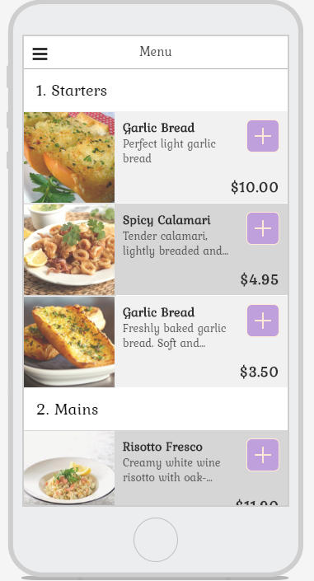
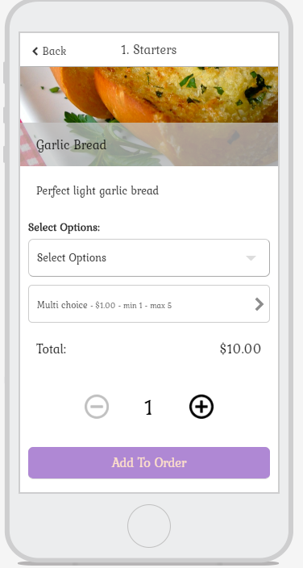
Menu includes items divided in 3 category:
Starters
Mains
Desserts.
Each item has a picture, name, information, price and ability to add it to the cart.
When user clicks on item, there will be all detailed information about item including modifiers selection (options/multi choice). Also there will be a price, amount and Add to Order button

Slide 10
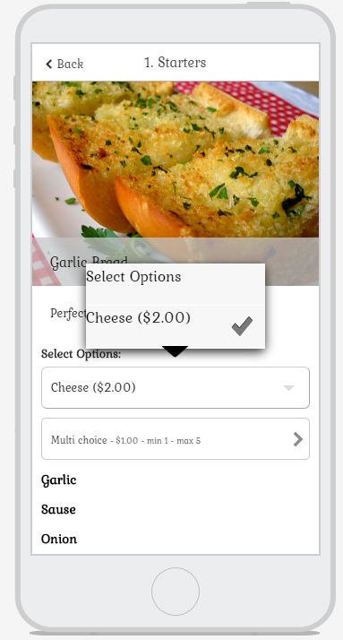
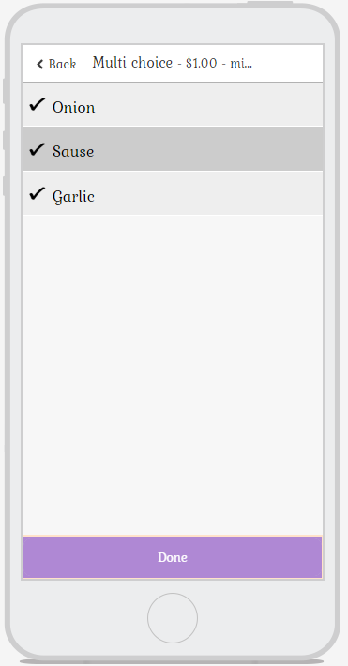
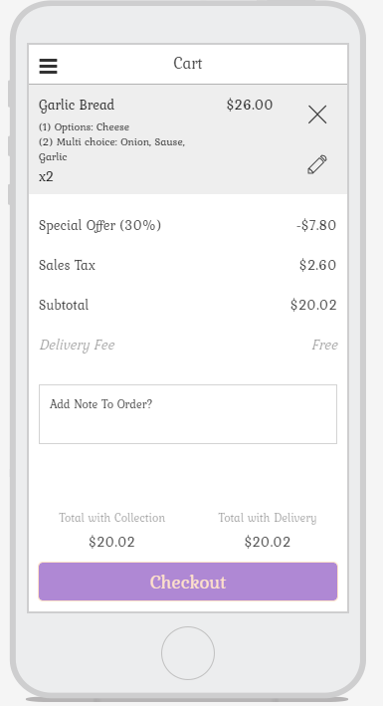
Can be edited or deleted

Slide 11
Requirements
Template should be created with the free Delphi 10.3 Rio Community Edition https://www.embarcadero.com/products/delphi/starter (latest update).
It should not use any 3rd party components except for those freely available via the GetIt package manager.
Any code beyond GetIt Packages or included libraries must be included with deliverable.
Include a document describing how to customize the template and the code should be well documented for easy customization.
All transitions should include proper material design animations.
Designed to work on iOS and Android, but also compatible with Windows and macOS

Slide 12
Deliverables
Reusable application template that implements online ordering functionality.
Behaviors as shown.
The content within the client area is only for demonstration purposes.
A document describing how to customize the template and the code should be well documented for easy customization.
All compatible with the free Delphi 10.3 Community Edition.
Tested and designed for iOS and Android with adequate support for Windows 10 testing

